Slide 1


Cyber Secure Mission
Welcome to OCPD Cyber Secure Mission Game
where you will have the opportunity to discover various cybersecurity best practices and become
a digital defender.
This game will put you in simulated real-world scenarios where you will face multiple cyber threats. By making the right choices, you will learn how to protect the company, yourself, and the people around you from potential cybersecurity attacks.
All the best!
OCPD IT
START

Slide 2
Cyber Secure Mission
Employee Name
Department Name

Slide 3

Stage 1
Fahad: Let us go to the new restaurant that we saw on the ad this morning, what do you think?
Khalid: I’m so hungry
Khalid: Agreed!

Slide 4

Stage 1
Khalid: Where’s the menu?
Fahad: Here it is

Slide 5
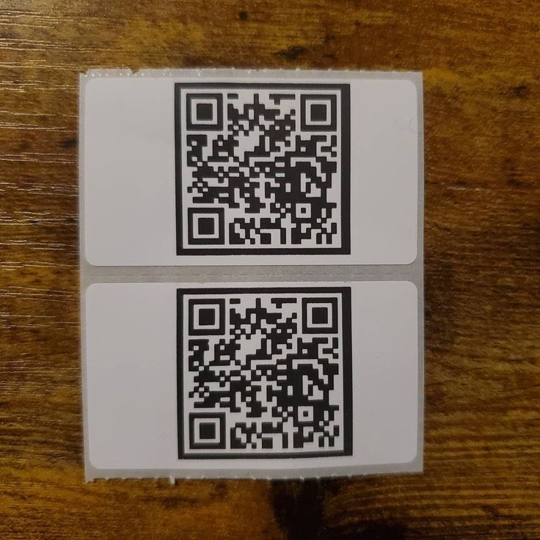
Stage 1
Pop-up Message
Scan it immediately
Verify its authenticity

Slide 6
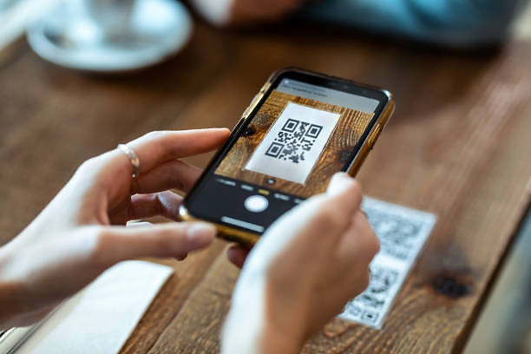
Stage 1
If the user scan it:

Slide 7
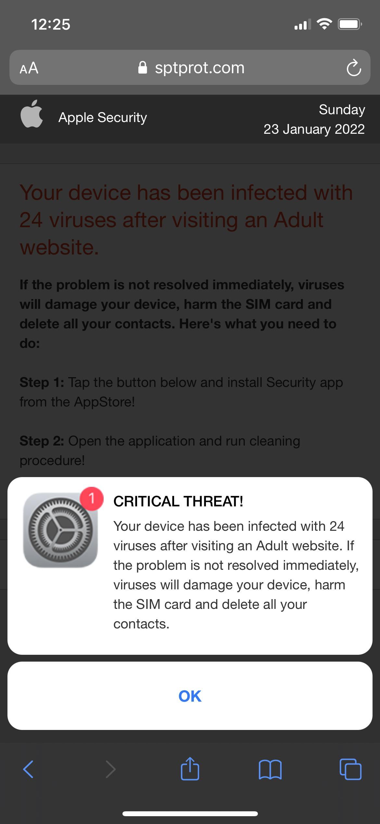
Stage 1
Your iPhone has been hacked

Slide 8

Stage 1
If you find a suspicious QR code, never scan it until you verify its authenticity.
In the previous case, you can ask the waiter or search for the restaurant menu utilizing the restaurant’s social media accounts.
Next Phase

Slide 9


Stage 1
If the user verify the QR code authenticity:
Correct!
If you find a suspicious QR code, never scan it until you verify its authenticity.
In the previous case, you can ask the waiter or search for the restaurant menu utilizing the restaurant’s social media accounts.
Next Phase

Slide 10
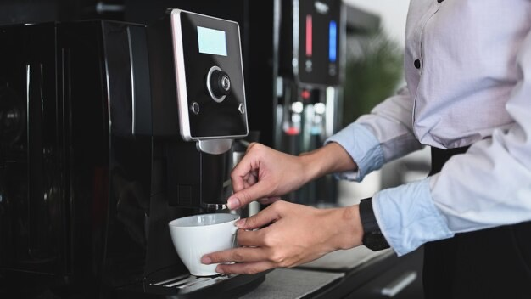
Stage 2
Fahad went to have a coffee

Slide 11
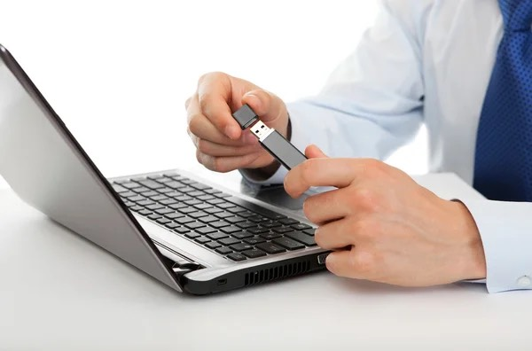
Stage 2
When Fahad came back to his office,
he saw a USB flash placed at his desk

Slide 12

Stage 2
Pop-up Message
Consolidate with
the IT team
Open it

Slide 13
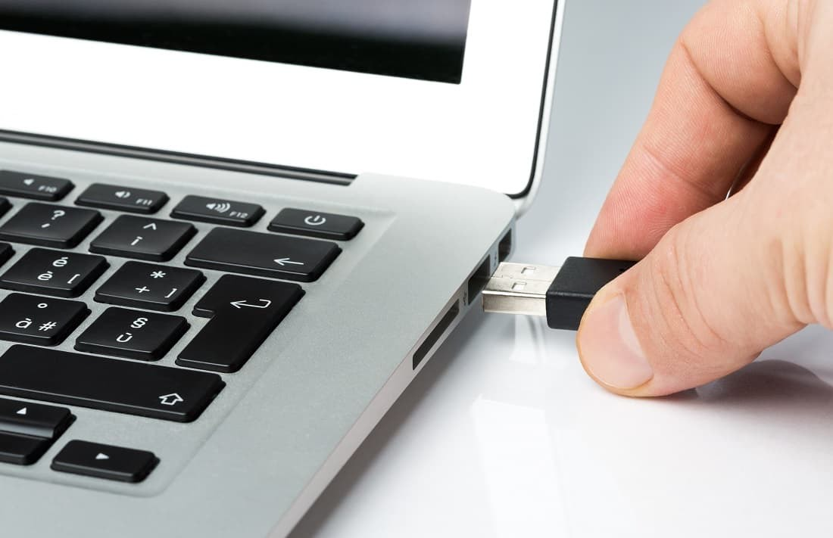
Stage 2
If he opened it:

Slide 14

Stage 2

Slide 15

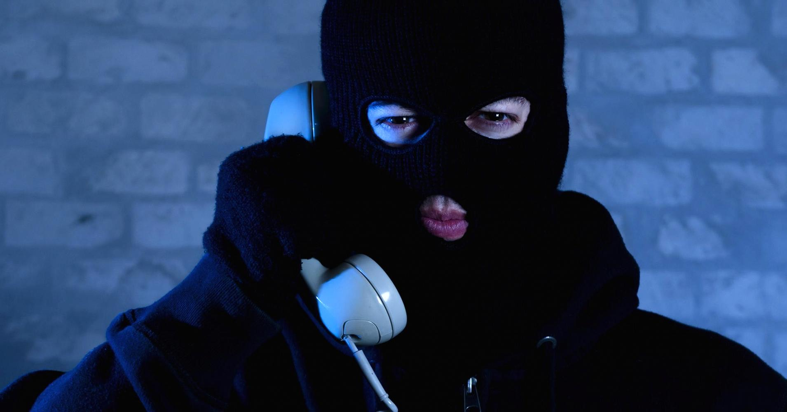
Stage 2
You didn’t think that was coming!!!!!!
Ha hah ha ha

Slide 16
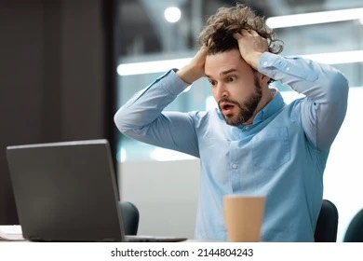
Stage 2

Slide 17
Stage 2
Never ever attach a USB flash to your device before checking it out especially if it does not belong to you
Next Phase

Slide 18
Stage 2
If the user consolidate with the IT team:
Correct!
Always remember not to open any USB flash before checking it out especially if it does not belong to you
Next Phase

Slide 19
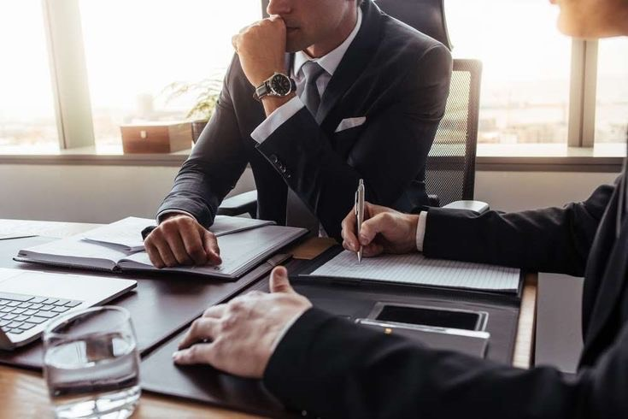
Stage 3
Ahmed: What do you think about the new Website ?
Ali: I think it’s good and it has a lot of features that we will be needed in the future.

Slide 20
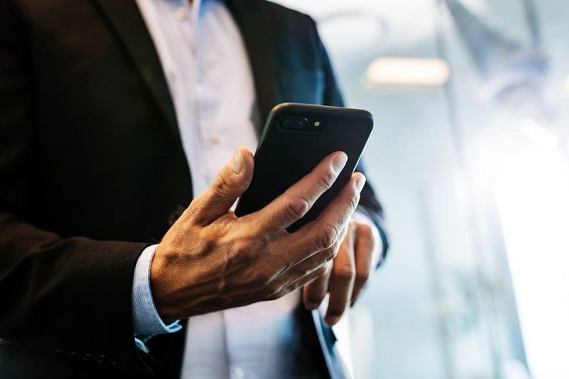
Stage 3
Someone called Ali’s mobile

Slide 21
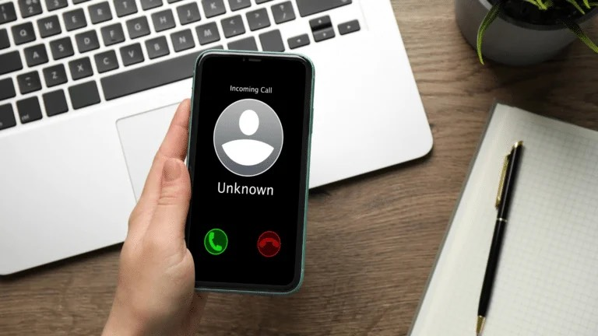
Stage 3

Slide 22

Stage 3
Hello, who is this ?
Hi Ali, How are you? I’m Khalid from the university club, we used to work together in multiple projects, do you remember me ?

Slide 23
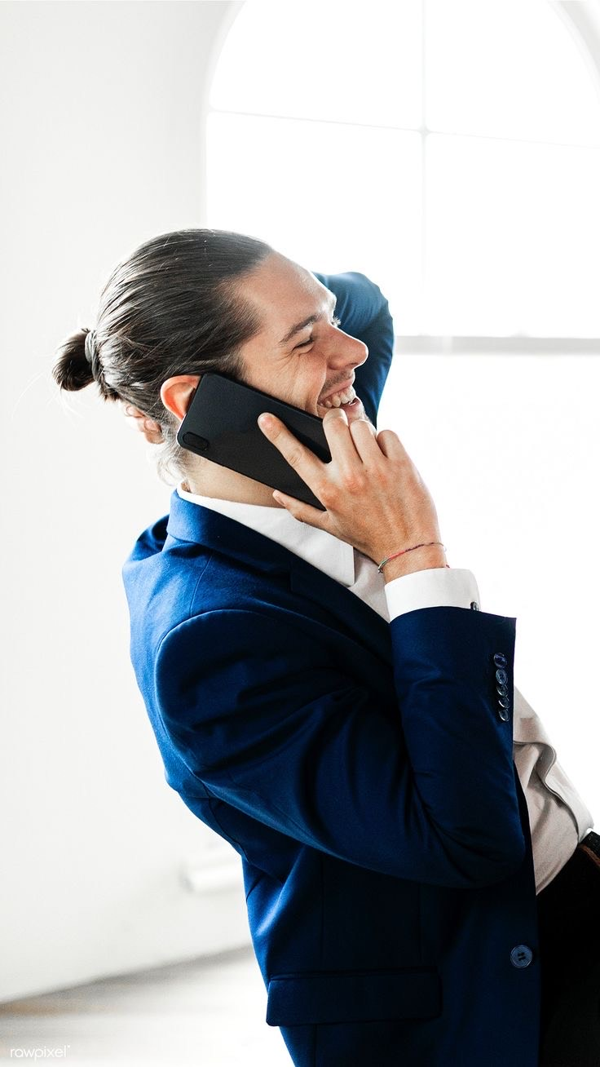
Stage 3
Oh I remembered you now, I'm fine, what about you?
I’m fine, thank you.
I wanted to ask you, are you coming to the university reunion gathering this Friday?
Oh, there’s a reunion gathering, I didn’t know!

Slide 24

Stage 3
Ok, thank you.
No problem, I will send you all the details on your Aramco email.
Your welcome, don’t forget to click on the link in the email to confirm your attendance.

Slide 25
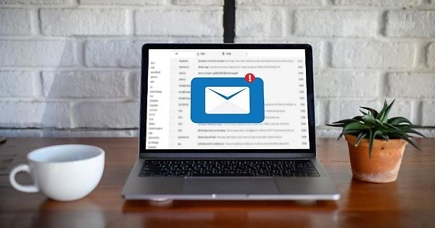
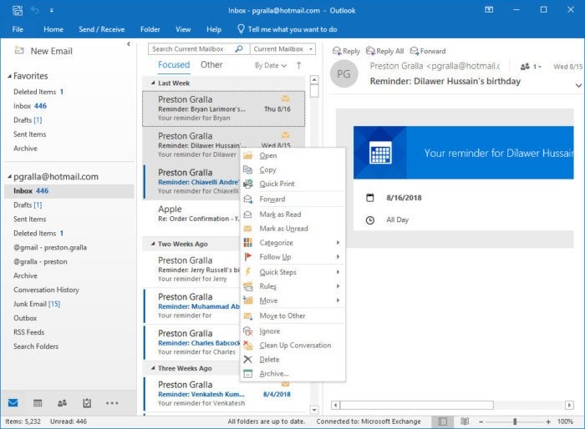
Stage 3

Slide 26
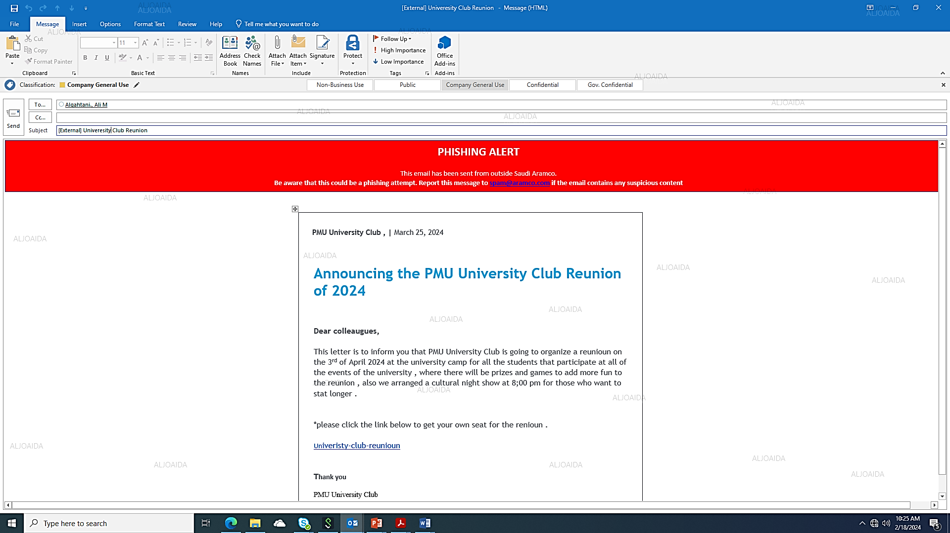
Stage 3
Pop-up Message
Click on the link
Report as SPAM

Slide 27
Stage 3
If he Clicked on the Link:
Always verify the 7 phishing indictors of any email you received before taking any action.
The 7 phishing indictors are as follow:
1. Sender Address
2. Subject of the Email
3. Phishing Alert
4. Body of the Email
5. Sense of Urgency
6. Embedded links or attachments
7. Spelling and Grammar Mistakes
Next Phase

Slide 28
Stage 3
If he report the email as spam :
Correct!
Always verify the 7 phishing indictors of any email you received before taking any action.
The 7 phishing indictors are as follow:
1. Sender Address
2. Subject of the Email
3. Phishing Alert
4. Body of the Email
5. Sense of Urgency
6. Embedded links or attachments
7.Spelling and Grammar
Next Phase

Slide 29
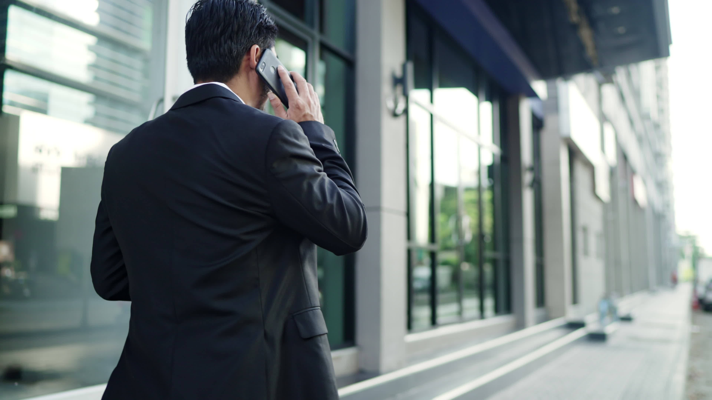
Ahmed was heading back from his lunch break

Slide 30
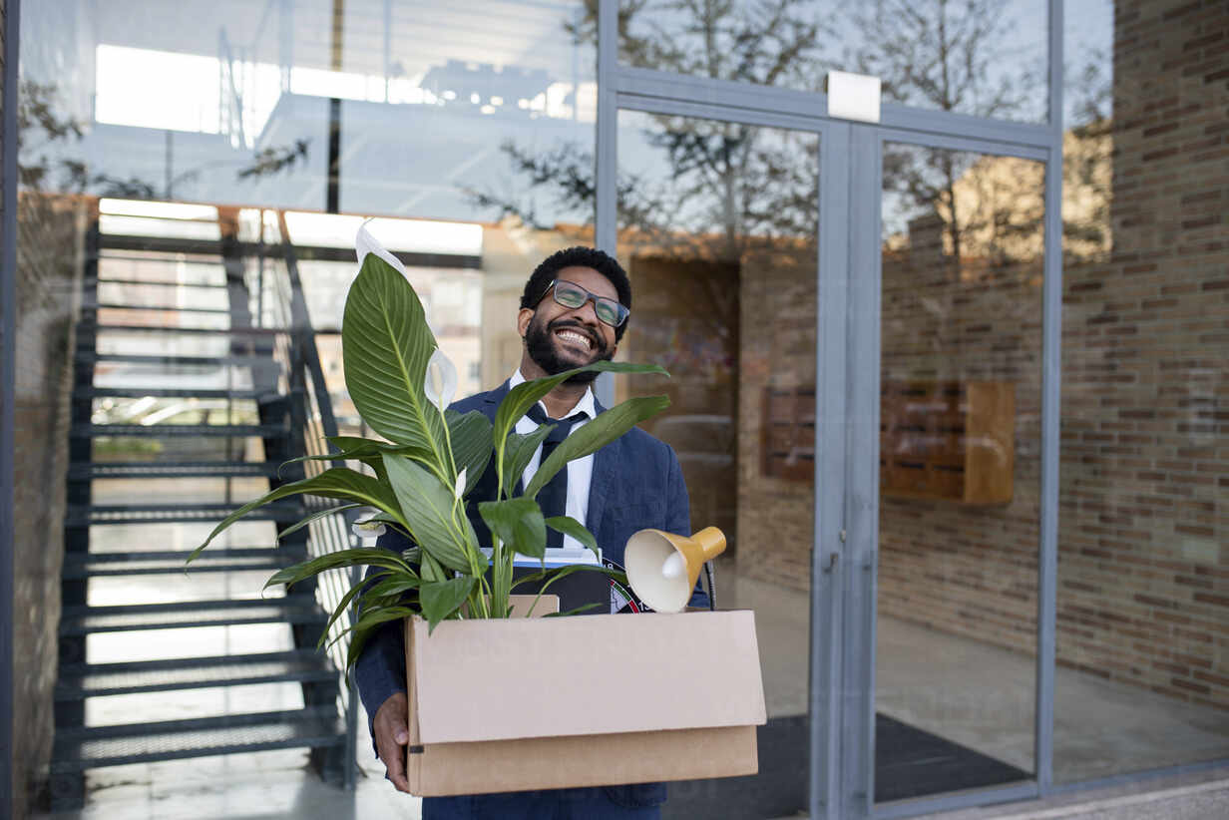
He saw someone holding a heavy box

Slide 31
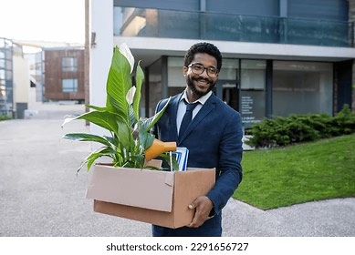
Faisal Saw Ahmed walking and he said:
Hi Ahmed, Good Morning, How are you today? I’m Faisal we used to work together before.
Hi, I’m fine thank you, sorry I don’t remember but anyway what’s the problem?

Slide 32
Faisal : Can you pass your ID Card so I can get in, as you can see I’m holding a heavy box ?
Ahmed : Oh, wait a minute

Slide 33
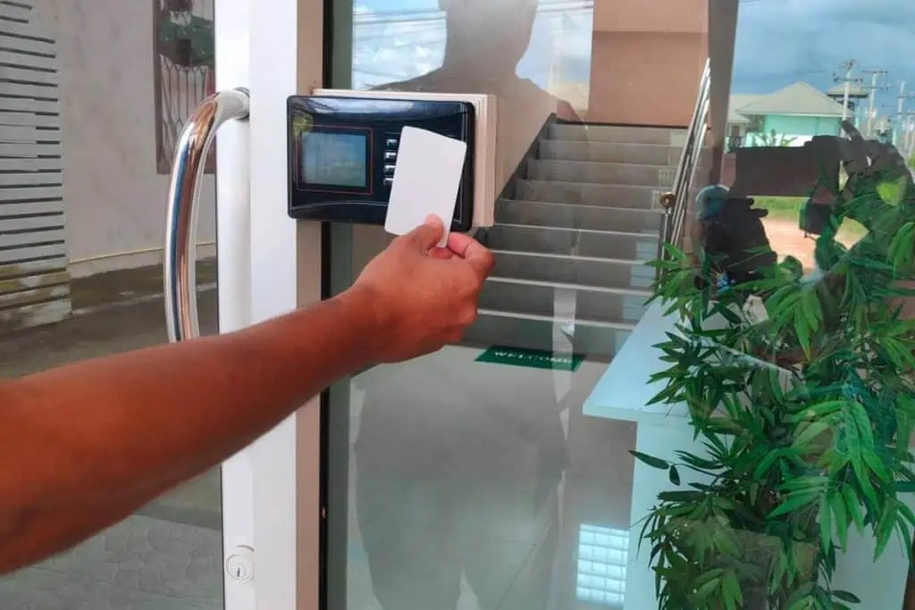
Pop-up Message
Pass the ID Card for him
Verify Faisal’s identity

Slide 34
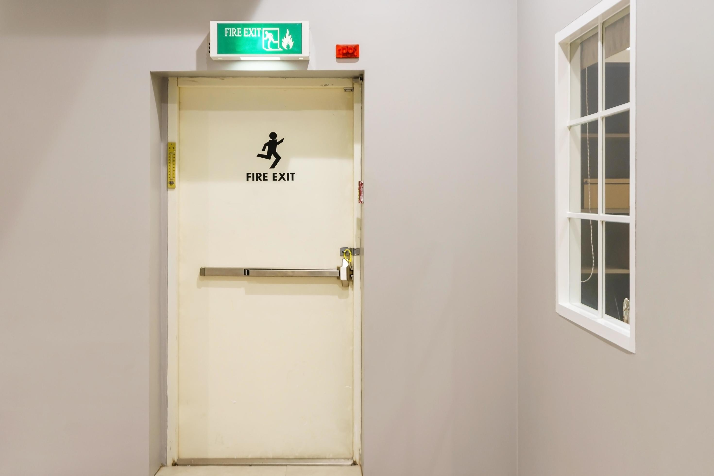
If he Passes the ID Card for him:
Faisal will throw the box on the Exit Room and follow Ahmed to his department floor

Slide 35

And steal confidential information , which will put his company at risk.

Slide 36
Stage 4
Always be aware of tailgating!
Never ever grant someone an access until you verify their identity.
Next Phase

Slide 37
Stage 4
If the user Verify Faisal’s identity:
Correct!
Always be aware of tailgating!
Never ever grant someone the access until you verify their identity.
Next Phase

Slide 38
Cyber Secure Mission
CONGRATULATIONS!
You have completed all phases.
Always remember to practice positive
cybersecurity behavior.
Thank you,
OCPD IT

